Slide 1
Next-Generation Polarized ³He Targets for Electron Scattering Experiments
Upcoming experiments in JLab with significantly higher beam current, such as Hall A A₁^{n} and G_{E}^{n}, Hall C A₁^{n}, will need better performance from target cells.
Today I will talk about some of the progress we have made and possibilities we’re exploring.
Special thanks to Yuan Zheng, Maduka Kaluarachchi, Daniel Matyas, Vladimir Nelyubin Al Tobias and Gordon Cates.
Yunxiao Wang
University of Virginia

Slide 2
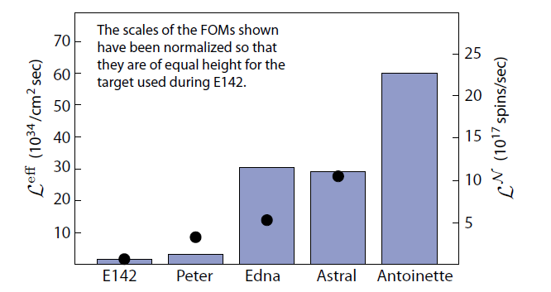
The performance of polarized 3He targets have
increased by roughly a factor of 30 since SLAC E142
This scale is for the black dots: luminosity weighted by P_{He}²
This scale is for the columns: number of spins polarized per second weighted by P_{He}²

Slide 3
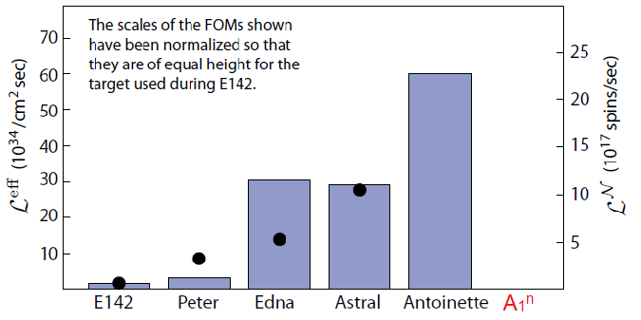
Where will Hall A A₁^{n} be?
Hall A A₁^{n}

Slide 4
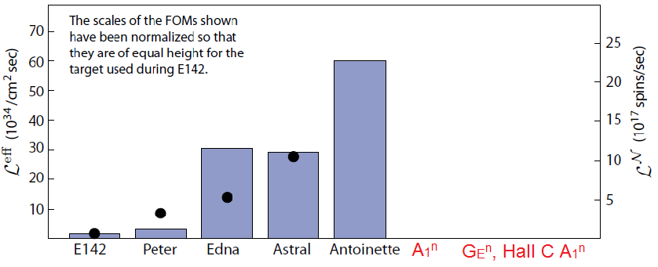
Where will G_{e}^{n}, Hall C A₁^{n} be?

Slide 5
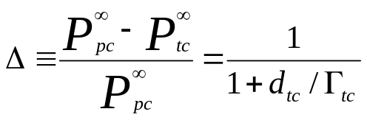
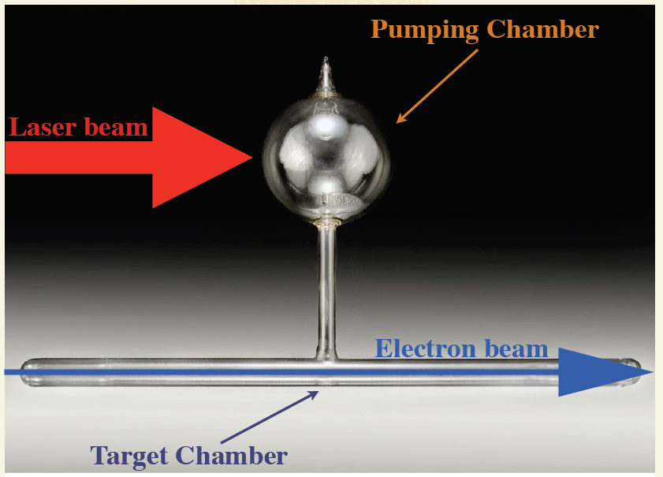
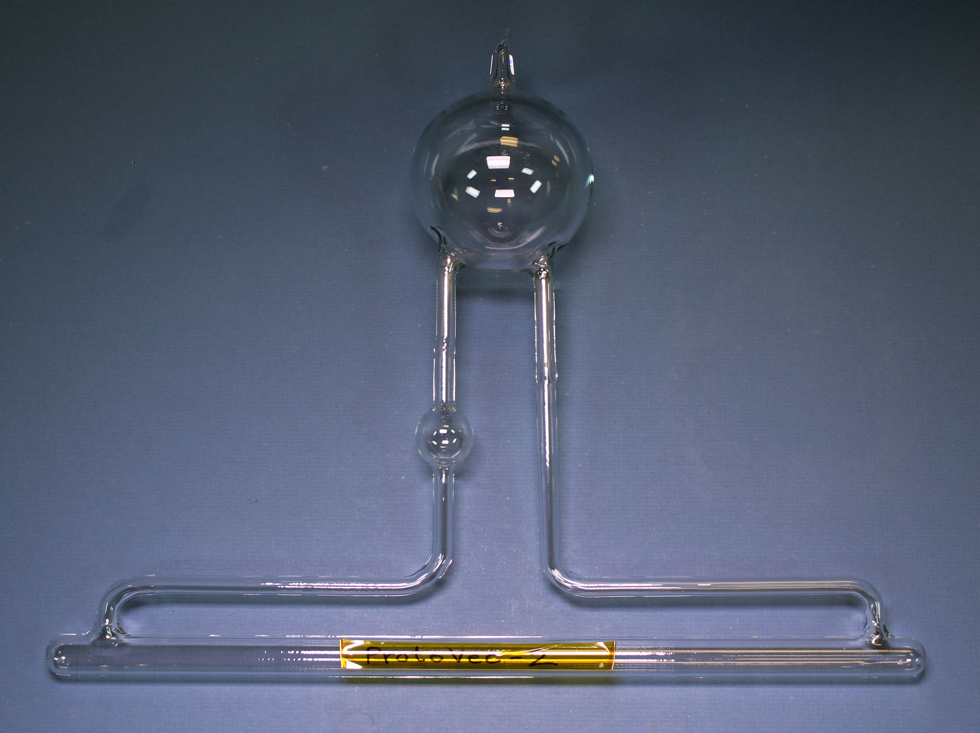
Why is convection important?
We define a relative polarization gradient:
d_{tc} is proportional to the rate at which ³He exits/enters target chamber
Γ_{tc} is the ³He relaxation rate in the target chamber

Slide 6
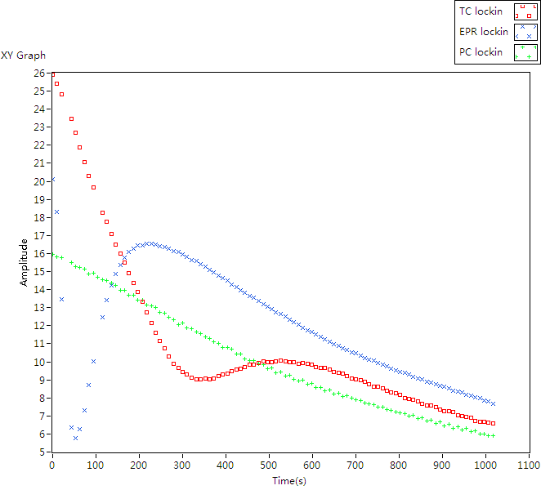
Convection style cell
Zapper coil
Convection Heater
Picked by coil 2
NMR coil 1
NMR coil 2
Picked by coil 1

Slide 7
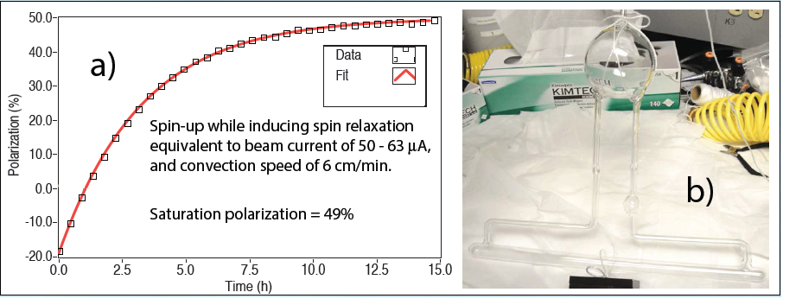
What’s the potential performance of a convection style cell?
³He and alkali metal vapor are constantly being swapped out of pumping chamber
Different geometry results in more surface area
Protovec 2
Simulated beam tests suggest that at least 49%, is achievable with 45μA on a Protovec-style cell.
It is likely that 55-60%, should be achievable with 30μA of beam on a Protovec-style cell.

Slide 8
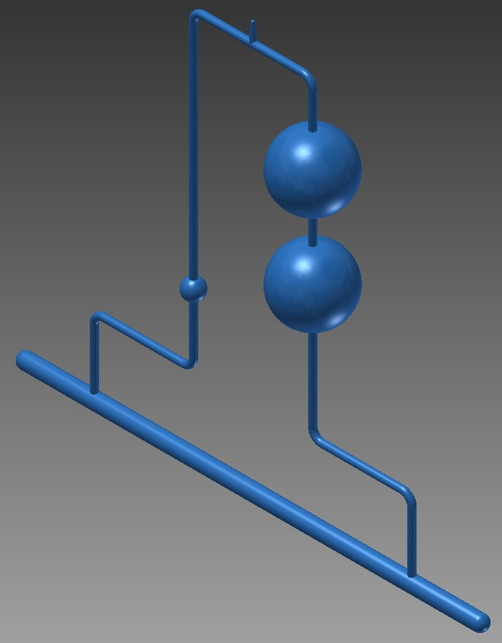
How can we maintain polarization if we triple luminosity from A₁^{n}?
Double pumping chamber
Target chamber 60 cm instead of 40 cm
Probably needs metal end windows

Slide 9
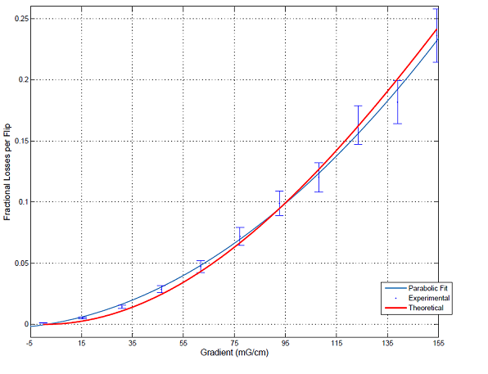
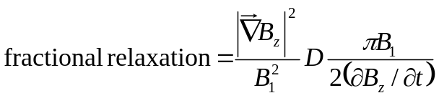
Large convection style cell will be subjected to significantly more magnetic field inhomogeneity
Losses during polarization measurements could be prohibitively large.
Based on our understanding on losses caused by measurements, we were able to position the cell so that losses will remain acceptable.

Slide 10
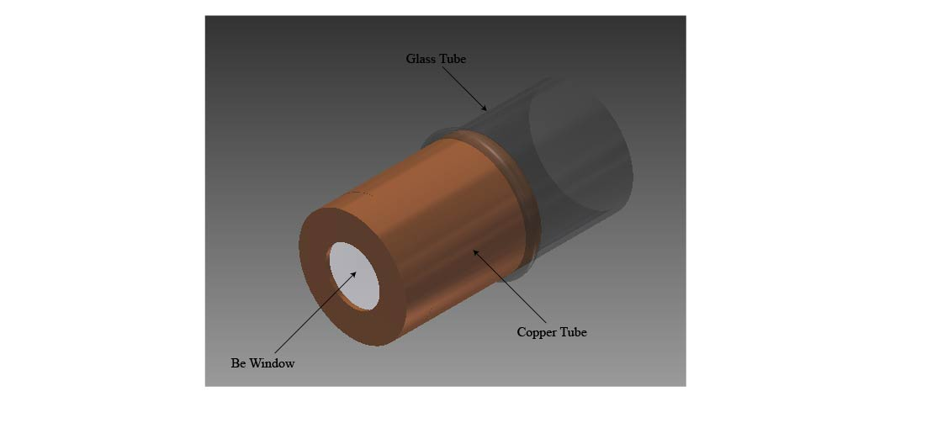
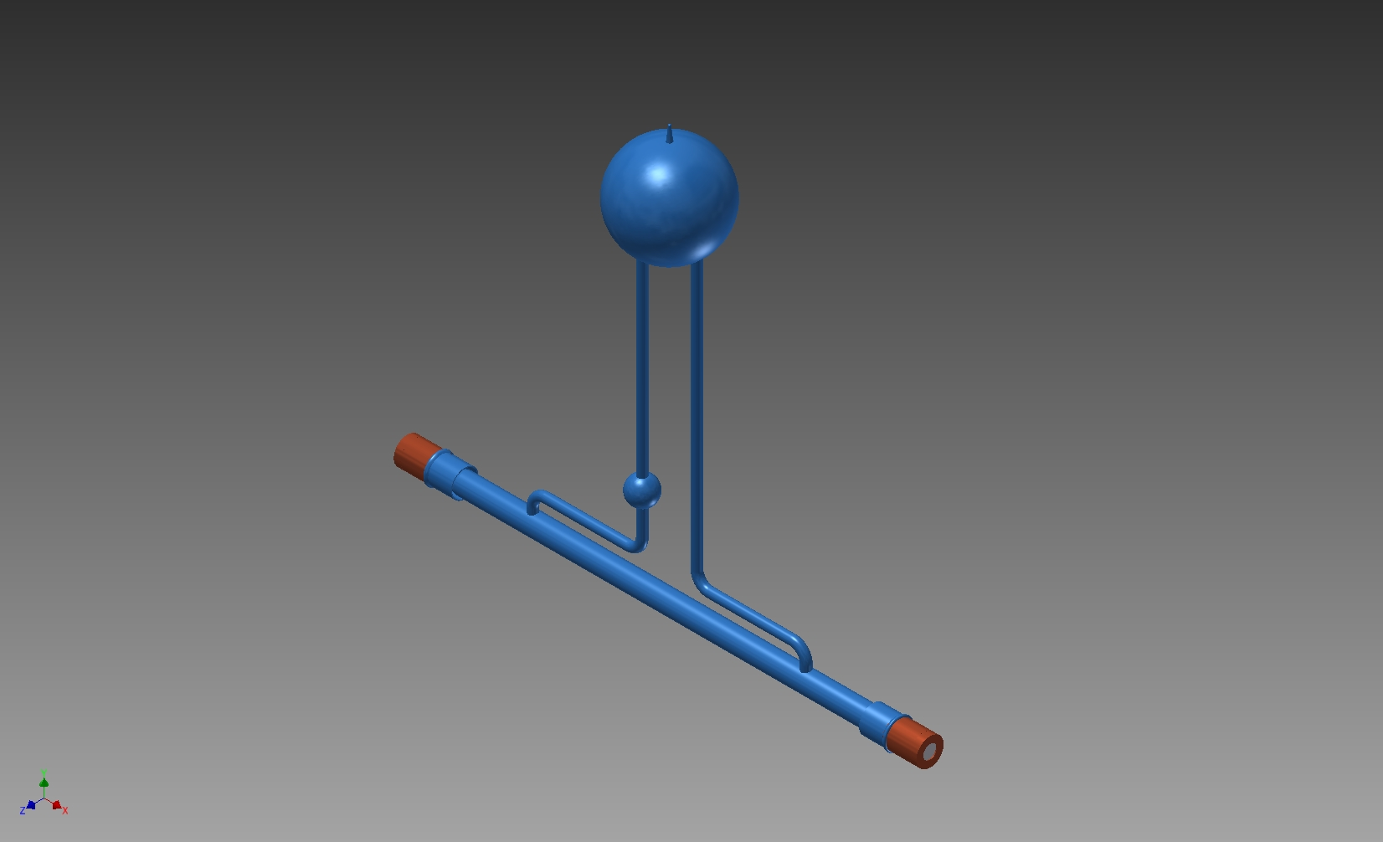
Metal end windows
In the past experiments, maximum beam current ever used was 15μA
After 12GeV upgrade, Hall A A₁^{n} will use 30 μA, glass window might still be sufficient
G_{E}^{n}, Hall C A₁^{n} is planning to use 60μA
Berylium window mounted on OFHC copper frame
Inner surface of copper coated with gold
Metal-to-aluminosilicate glass seal
Gold shown at Mainz has ~22hr spin relaxation time for ³He target, but Mainz tests did NOT involve alkali metals

Slide 11
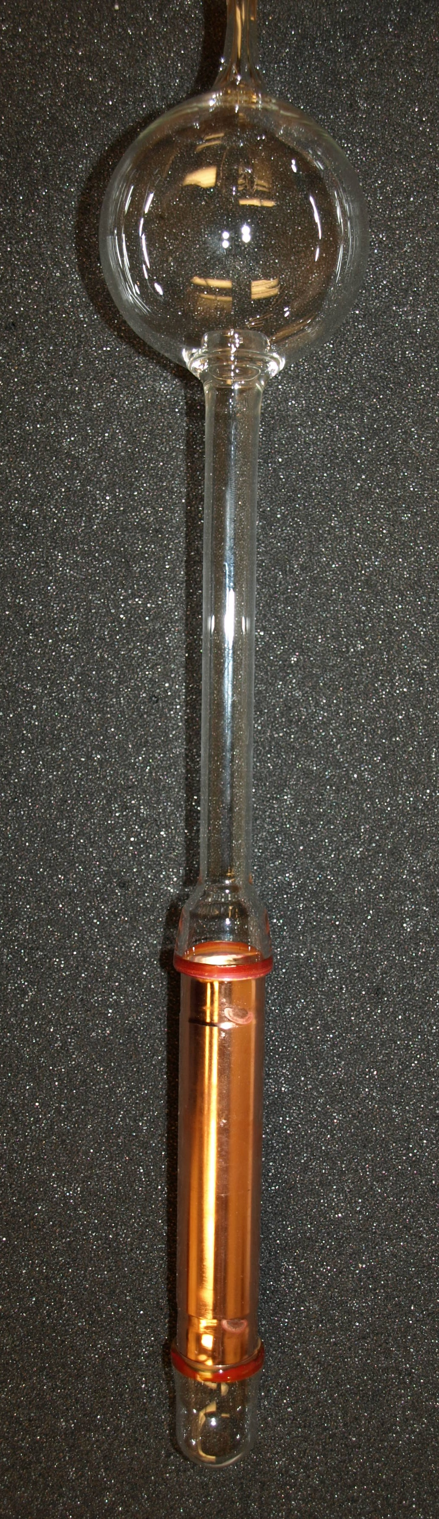
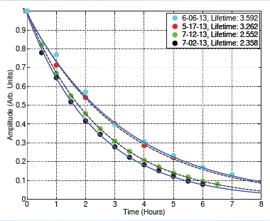
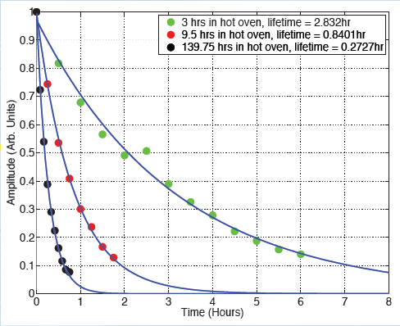
Studies are on going on the spin relaxation on various metals
We’ve found spin relaxation increases with exposure to Rb.
Gold electroplated onto OFHC copper
Electropolished OFHC copper

Slide 12
Thank you!

